Slide 1
Usability Testing INLS 719 Fall 2018 Mobile AR via IKEA Place App
The AR Heels
Wenyuan Wang Leah Ramsier
Eugene Bang Austin R. Ward

Slide 2
Introduction
IKEA is Swedish multinational corporation that sells, among many things, ready-to-assemble furnishings
The IKEA Place mobile app uses augmented reality to show virtual furniture in users’ homes
The AR Heels
Notes:
~1 minutes

Slide 3
Evaluation Goals
Do a usability evaluation of the mobile augmented reality components of the IKEA Place app
The limited scope of current mobile AR allows for a focus on whether interfaces, instructions, and new paradigms are communicable and understandable by new users.
The AR Heels
Notes:
~1 minutes

Slide 4
Background: How the system works
The camera scans the environment, calculating a platform
The AR image is produced with respect to the platform
The size of the image depends on where it located at the platform
The size of the furniture is not changeable
When placed down (check mark) the AR image will stay
The AR Heels
Notes:
~5 minutes

Slide 5
Test Design
Think-Aloud
3 Tasks representing key functions of app
1 Moderator and 1 Tech
Post-Task Questionnaire
Post-Study Interview
The AR Heels
Notes:
~5 minutes

Slide 6
Test environment, equipment and materials
Classroom
iPhone SE w/screen recording software
Markers on floor for furniture placement during test
Online questionnaire administered on laptop
Moderator reading from script
Tech in room for assistance
The AR Heels
Notes:
~5 minutes

Slide 7
Tasks
Task 1: Position
While standing on the USER marker, use the app to find the Markus chair and place it in the room on the CHAIR marker.
Task 2: Rotate
While standing on the USER marker, use the app to find the Markus chair and place it in the room on the CHAIR marker, in the orientation indicated by the marker.
Task 3: Configure
While standing on the USER marker, use the app to find the Markus chair and place it in the room on the CHAIR marker. Do the same for Micke desk on the DESK marker and the Hektar lamp on the LAMP marker.
The AR Heels
Notes:
~5 minutes

Slide 8
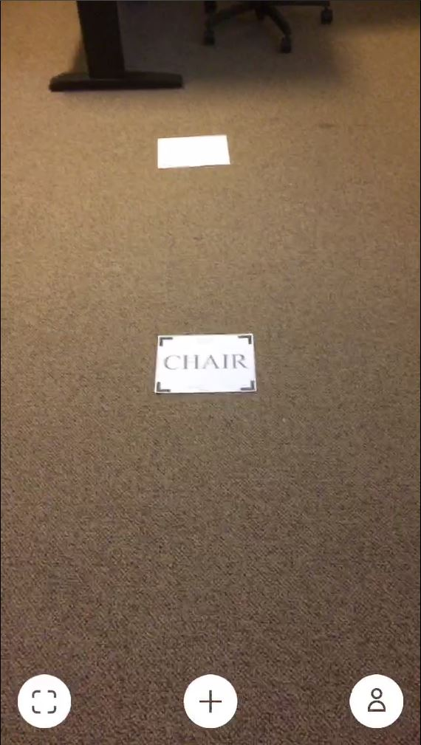
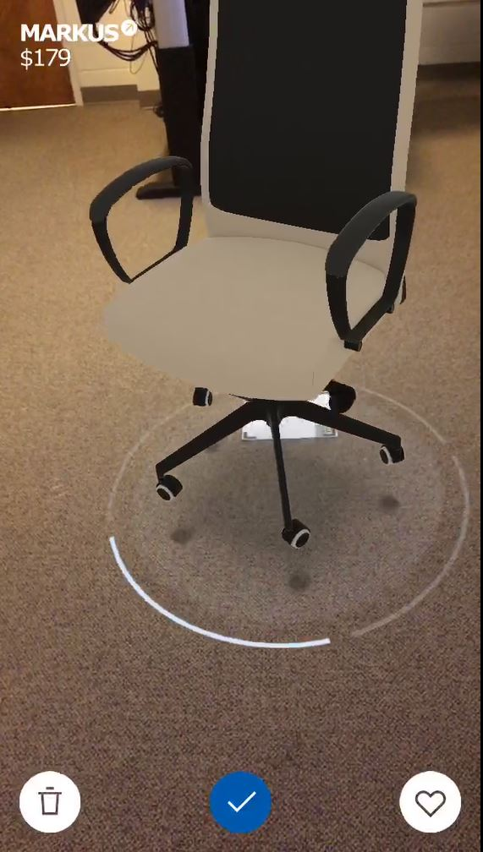
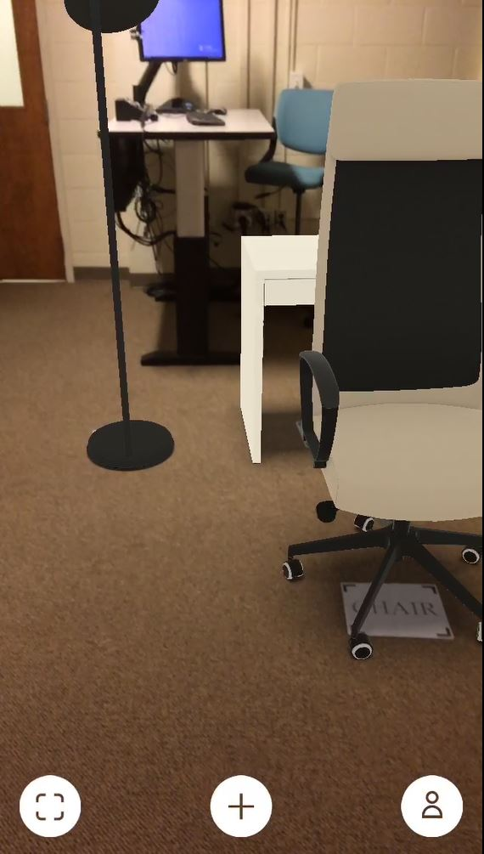
Tasks
Position
Rotate
Configure
The AR Heels

Slide 9
Data Collected
Post-Task Questionnaire
ASQ+
The AR Heels
Notes:
~2 minutes

Slide 10
Data Collected
Interview + Audio Recordings
10 questions
Screen Recordings
The AR Heels

Slide 11
Data Analysis Overview
Participant Performance
Participant Success
Task Issues
Participant Satisfaction
The AR Heels
Notes:
~2 minutes

Slide 12
Participant Performance
Participants showed surprise (both good and bad) upon first use of the app
The virtual furniture was large and participants expressed frustration trying to reduce the size
Most participants figured out drag function after several attempts
Rotation task was difficult for everyone, most participants misunderstood how it could be done
We observed learning curve got smoother moving to task 3, but it was still a bit uneasy for participants that didn’t get the first one right
The AR Heels
Notes:
~7 minutes

Slide 13
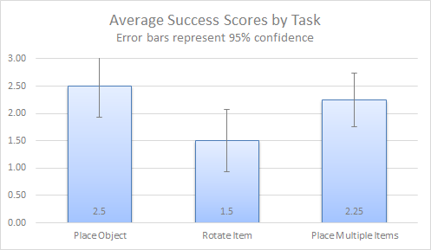
Participant Success
The AR Heels
Notes:
~2 minutes

Slide 14
Task Issues
Participant | Task 1 | Task 2 | Task 3
P1 | 2 | 1 | 0
P2 | 0 | 0 | 0
P3 | 1 | 1 | 0
P4 | 2 | 1 | 0
Do not know how to move object
Do not know how to rotate object
Do not know how to resize object
The AR Heels
Notes:
~2 minutes

Slide 15
Participant Satisfaction
ASQ Q3 showed lack of satisfaction with help documentation
Questionnaire results skewed toward satisfaction with way furniture looks in real environment
Room for increasing satisfaction
Interviews showed satisfaction with the way furniture looks in the real environment, but mixed results with the way furniture can be moved around the real environment
Average ASQ Scores (Inverted)
Task 1 - 4.42
Task 2 - 3.5
Task 3 - 4.75
The AR Heels
Notes:
~7 minutes

Slide 16
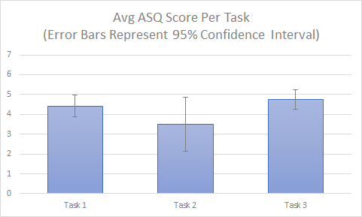
Participant Satisfaction
The AR Heels
Notes:
~7 minutes

Slide 17
Recommendations
Inform users how the size of virtual furniture is calculated and why it cannot be resized
Inform users how to position virtual furniture
Inform users how to rotate virtual furniture
Inform users why they need to scan their environments
The AR Heels
Notes:
~2 minutes

Slide 18
Conclusion
New/novel interfaces may not meet users’ expectations
If the way the system works is not revealed to the users, and they might have misunderstanding on certain functions
A tutorial and/or help documentation would likely to solve all the non-tech related problems
The AR Heels
Notes:
~1 minutes

