Slide 1
Human Factors and Music Streaming Services
By Leah Ramsier

Slide 2
Music Interaction
“Music Interaction encompasses the design, refinement, evaluation, analysis and use of interactive systems that involve computer technology for any kind of musical activity, and in particular, scientific research on any aspect of this topic.” (Holland, Wilkie, Mulholland, & Seago, 2013, p.5)
Listening is how people interact with streaming services

Slide 3
Context and Context Factors in Streaming Services
Context = information about entities relevant to the interaction between the user and the system
Location
Time
Identity
Activity
Secondary context factors come from these

Slide 4
Location
Share music with others based on location
Allows for serendipity

Slide 5
Time
Different music at different times
Morning vs. Evening
Weekday vs. Weekend

Slide 6
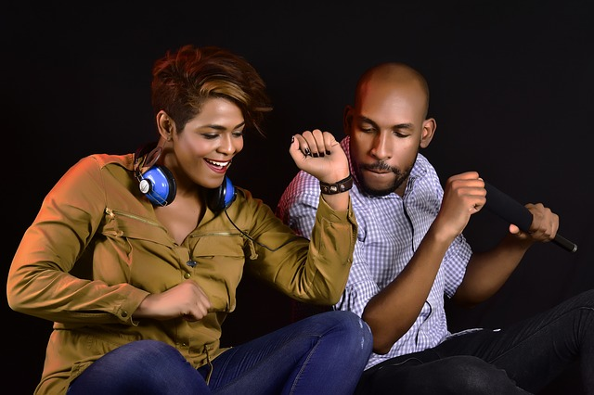
Identity
Relational aspect to streaming services
Social aspects improve UX
Ex. See what the people you trust/the people who have good taste are listening to

Slide 7
Activity
Different needs for different activities
Examples: Driving, sports
Systems need to consider these activities in UI design
Automatically pick music for user based on activity – saves work
Some services may give users more control, though users tend to prefer not having to do a lot of work upfront

Slide 8
Personas of Music Streaming Service Users
Companionship
Desire to engage w/social aspects of music streaming
Investment
Desire to engage w/system

Slide 9
Takeaways from Personas
Engagement may not be the best metric for success, some people are happiest with minimal effort
Improve navigation – go down a trail and little guidance on how to get back

Slide 10
Takeaways from Personas cont.: More Contexts
Level of attention
Level of energy/motivation
Mood
Temporal Aspect

Slide 11
Considering Contexts
Give users control
Have system track context and let the system be in control

Slide 12
Serendipity
Four dimensions
Introducing the unexpected – introduce new music
Accessibility – make music easy to browse
Navigability – make it easy to use the system
Enabling connection – connection between music

Slide 13
Serendipity Cont.
Different users have different preferences when it comes to serendipity
Psychological characteristics may influence this
High music involvement
Openness to novelty

Slide 14
Personalization
Lots of music (and other audio) available through streaming services
Personalized recommendations improve user experience
One solution: recommend a song based on another song a user liked

Slide 15
Flow and music streaming
Flow is a state of absorption, enjoyment, and motivation for a task
Social presence, ease of use, and content richness precede flow
Flow can lead to satisfaction and reuse of the system
This concept can be applied to music streaming

Slide 16
SuperMusic
Context-aware (location and time)
Users enjoyed the concept, though there were some human factors issues
Context-aware recommendations struggled, while similar song recommendations performed well
Users wanted to see why songs were recommended
Social features hidden away

Slide 17
Spotify Evaluation
Basic functionalities meet users’ needs
Advanced functionalities pose difficulties
Differences between mobile and desktop app confused users
Ex. Different way of presenting history

Slide 18
YouTube
Not intended for music streaming, but…
Finnish study found that YouTube videos had twice the views that Spotify songs had plays
Retention was also found to be better on YouTube

Slide 19
Main Takeaways
Find the best way to present information to the user (there’s so much of it; the system needs to help)
Consider the context
Recognize users have different desires for streaming services
Make it personal for the user

Slide 20
References
Åman, P., & Liikkanen, L. A. (2017).. International Journal of Human–Computer Interaction, 33(3), 165-179.
Chang, Y. H., & Tang, M. C. (2018, March). Serendipity with Music Streaming Services: The Mediating Role of User and Task Characteristics. In International Conference on Information (pp. 435-441). Springer, Cham.
Demir, Ö., Yakushev, A. R., Keddo, R., & Kallio, U. (2017). Item-Item Music Recommendations With Side Information. arXiv preprint arXiv:1706.00218.
Holland, S., Wilkie, K., Mulholland, P., & Seago, A. (2013). Music interaction: understanding music and human-computer interaction. In Music and human-computer interaction (pp. 1-28). Springer, London.
Lee, J. H., & Price, R. (2015, October). Understanding Users of Commercial Music Services through Personas: Design Implications. In ISMIR (pp. 476-482).
Lehtiniemi, A. (2008, December). Evaluating SuperMusic: streaming context-aware mobile music service. In Proceedings of the 2008 international conference on Advances in Computer Entertainment Technology (pp. 314-321). ACM.
Liikkanen, L. A. (2014, November). Music interaction trends in Finland: YouTube and Spotify. In Proceedings of the 18th International Academic MindTrek Conference: Media Business, Management, Content & Services (pp. 127-131). ACM.
Lindegren, D. (2016). User Experience Evaluation of a Streaming Music System.
Wang, K., & Huang, S. T. (2014, December). How flow experience affects intention to use music streaming service: Model development. In Proceedings of the 12th International Conference on Advances in Mobile Computing and Multimedia(pp. 451-457). ACM.

