Slide 1
Virtual Reality Art
By Leah Ramsier

Slide 2
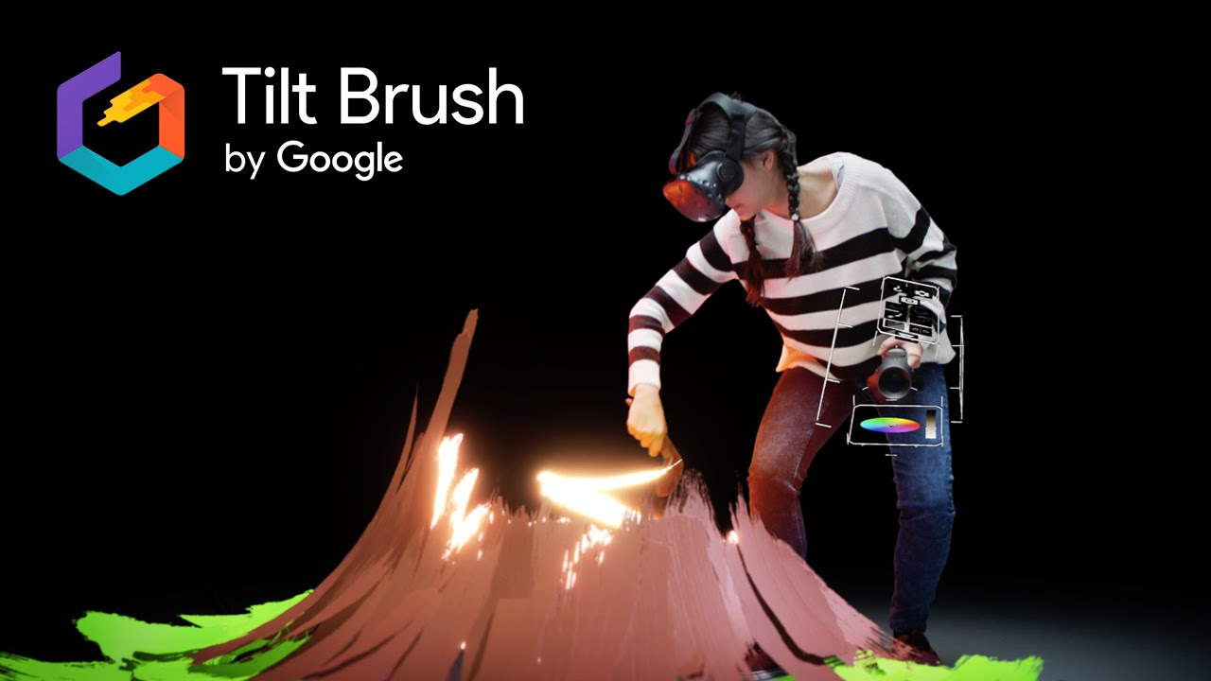
VR Art
Image from: https://i.ytimg.com/vi/TckqNdrdbgk/maxresdefault.jpg

Slide 3
Making VR Art
Elements from 2D art (like painting) and 3D art (like sculpting)
Unencumbered by the laws of physics

Slide 4
VR Basics
Virtual Environments: “a computer generated display that allows or compels the user (or users) to have a sense of being present in an environment other than the one they are actually in, and to interact with that environment.” (Schroeder, 2008, p.2)

Slide 5
Head-mounted Displays (HMDs)
HMDs: Type of VR device
Usability issues from being unable to perceive reality while using HMDs
Criticized as impractical

Slide 6
Presence and Immersion
Presence: user’s sense of “being there”
Implications for cognition
Immersion: the technology’s ability to create a sense of reality
Implications related to technology

Slide 7
Implications for Human Factors
Consider how user will behave if they feel a sense of presence in an immersive VR environment

Slide 8
Implications for Human Factors
How to keep use immersed in HMD while keeping them functional in reality
What does this mean for art?

Slide 9
Movement
Artists can move freely through 3D space to create art that can be experienced
Teleportation possible

Slide 10
Factors of Effective Travel Techniques (Bowman et al., 1997)
Speed
Accuracy
Spatial Awareness
Ease of Learning
Ease of Use
Information Gathering
Presence

Slide 11
Position
Position is tracked so position in VR can map to position in real world
Important to mimic real life so user doesn’t get disoriented

Slide 12
VR Implications for Art
Exist in virtual environment and real world simultaneously
Experience three-dimensional, immersive art
Example: move through a painting

Slide 13
Example: Gnome Sweet Gnome by Alex Hirsch

Slide 14
Human Factors Considerations
Notice the perspective, head on
Wouldn’t look right from a different angle

Slide 15
Human Factors Considerations
Traveling through wall
Space outside tree and inside tree
Need a certain range of motion to travel that far

Slide 16
Applications of VR Art
New art medium
Museums
Art Therapy
Education

Slide 17
Limitations to Consider: Art Therapy
Motion-sickness
Difficulty with communication

Slide 18
Educational Benefits
Experiment compared two-dimensional painting to VR painting
Cognitive benefits identified: encourages abstract thinking

Slide 19
Potential for Research
Identify how immersive art affects cognition
Identify what factors contribute to ease/difficulty of use on VR painting interfaces (my master’s paper)

Slide 20
References
Antonietti, A., & Cantoia, M. (2000). To see a painting versus to walk in a painting: an experiment on sense-making through virtual reality. Computers & Education, 34(3-4), 213-223.
Bowman, D. A., Koller, D., & Hodges, L. F. (1997, March). Travel in immersive virtual environments: An evaluation of viewpoint motion control techniques. In Virtual Reality Annual International Symposium, 1997., IEEE 1997 (pp. 45-52). IEEE.
Buxton, B., & Fitzmaurice, G. W. (1998). HMDs, caves & chameleon: a human-centric analysis of interaction in virtual space. ACM SIGGRAPH Computer Graphics, 32(4), 69-74.
Hacmun, I., Regev, D., & Salomon, R. (2018). The Principles of Art Therapy in Virtual Reality. Frontiers in psychology, 9.
Keefe, D. F., Feliz, D. A., Moscovich, T., Laidlaw, D. H., & LaViola Jr, J. J. (2001, March). CavePainting: a fully immersive 3D artistic medium and interactive experience. In Proceedings of the 2001 symposium on Interactive 3D graphics (pp. 85-93). ACM.
Kimer, T. G., & Martins, V. F. (1999). A model of software development process for virtual environments: definition and a case study. In Application-Specific Systems and Software Engineering and Technology, 1999. ASSET'99. Proceedings. 1999 IEEE Symposium on (pp. 155-161). IEEE.
McGill, M., Boland, D., Murray-Smith, R., & Brewster, S. (2015, April). A dose of reality: Overcoming usability challenges in vr head-mounted displays. In Proceedings of the 33rd Annual ACM Conference on Human Factors in Computing Systems (pp. 2143-2152). ACM.
Morie, J. F. (2008, February). Ontological implications of Being in immersive virtual environments. In The Engineering Reality of Virtual Reality 2008 (Vol. 6804, p. 680408). International Society for Optics and Photonics.
Slater, M., & Wilbur, S. (1997). A framework for immersive virtual environments (FIVE): Speculations on the role of presence in virtual environments. Presence: Teleoperators & Virtual Environments, 6(6), 603-616.
Zimmerman, G. W., & Eber, D. E. (2001, February). When worlds collide!: an interdisciplinary course in virtual-reality art. In ACM SIGCSE Bulletin (Vol. 33, No. 1, pp. 75-79). ACM.

